Slide 1

Chapter 2 – Software Processes
Chapter 2 Software Processes

Slide 2
Topics covered
Software process models
Process activities
Coping with change
The Rational Unified Process
An example of a modern software process.
Chapter 2 Software Processes

Slide 3
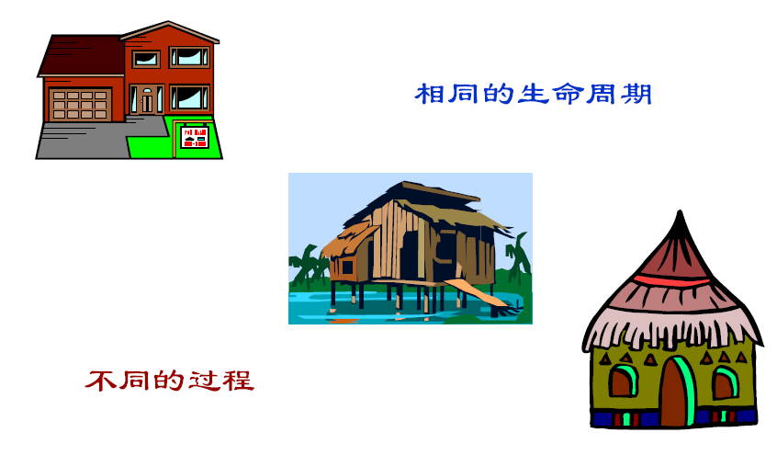
Different process of building the houses
The same life cycle
Different processes

Slide 4
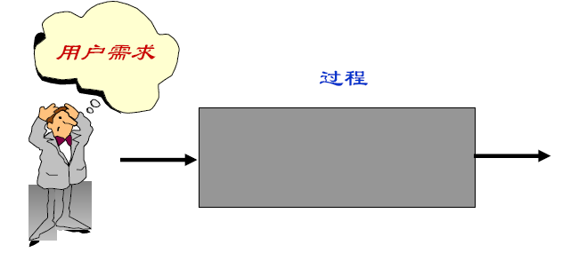
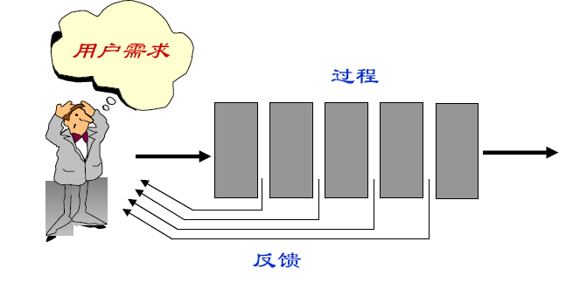
Two modes for producing software
Process
Software
The invisible process
Process
Software
A visible Process
Feedback

Slide 5
The software process
A structured set of activities required to develop a software system.
Many different software processes but all involve:
Specification – defining what the system should do;
Design and implementation – defining the organization of the system and implementing the system;
Validation – checking that it does what the customer wants;
Evolution – changing the system in response to changing customer needs.
A software process model is an abstract representation of a process. It presents a description of a process from some particular perspective.
Chapter 2 Software Processes

Slide 6
Software process descriptions
When we describe and discuss processes, we usually talk about the activities in these processes such as specifying a data model, designing a user interface, etc. and the ordering of these activities.
Process descriptions may also include:
Products, which are the outcomes of a process activity;
Roles, which reflect the responsibilities of the people involved in the process;
Pre- and post-conditions, which are statements that are true before and after a process activity has been enacted or a product produced.
Chapter 2 Software Processes

